Slide 1
Event-oriented Data Aggregation for WSN

Slide 2



Weekly Report (25/02/2008)
Problem definition
  Given a number of event definitions
    Each event has >=0 attributes
    Attributes can be primitive such as one single sensor reading or composite such as average sensor readings.
    One of the event is subscribed
  To construct an aggregation tree so that the total number of messages used to detect and report the subscribed event can be less than traditional aggregation techniques.

Slide 3
Motivation
Composite event detection can be regarded as data aggregation problem
Existing data aggregation models are not suitable for event-oriented data aggregation.
A holistic approach will be better:
  Take the event description into consideration when aggregating data
  Better energy saving can be achieved by taking advantage of the additional information

Slide 4
Why?
  Composite event detection can be regarded as data aggregation problem
  Existing data aggregation models are not suitable for event-oriented data aggregation.
  A holistic approach will be better:
    Take the event description into consideration when aggregating data
    Better energy saving can be achieved by taking advantage of the additional information

Slide 5

Ideas
  Generalize the idea of data aggregation in WSN (not just mean, median …).
  Further energy saving is possible when aggregation is closely integrated with the algorithm.
  How?
    Provide a middleware layer
    Provide a language expressive enough

Slide 6
Related Works
  Some of the early works ([LEACH] [PEGASIS]): assumptions may not be appropriate.
  MAC-layer aggregation ([AIDA], [DAA & RW]): cannot take advantage of the extra application information.
  Database solutions ([TAG], [GaNC & TiNA]): only simple aggregations.
  Math solutions ([Statistical Aggregation], [q-digest], [Deterministic Weighted Sampling]): more sophisticated but still not enough.
  Energy-based clustering ([LPT], [LP], [iHEED], [EPAS], [MFST]).
  QoS-based clustering ([Q-DAP]).
  Mostly related: [Sparse Aggregation] but makes a very strong / unreasonable assumption.

Slide 7
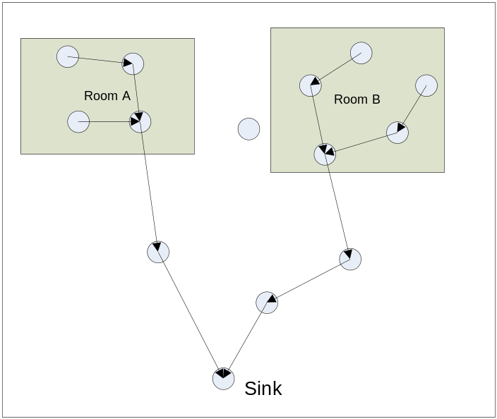
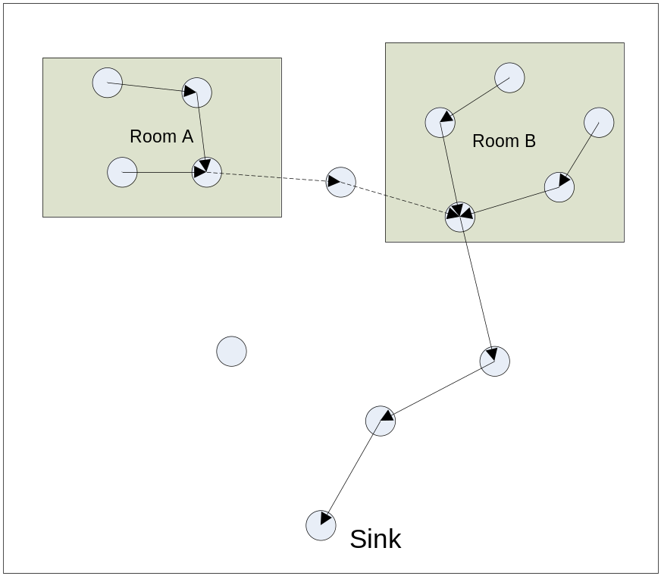
Detailed solution
  Example: Detect a composite event such that the temperature of room A rises above 30 then after 10 minutes, the temperature of room B also rises above 30.

Slide 8
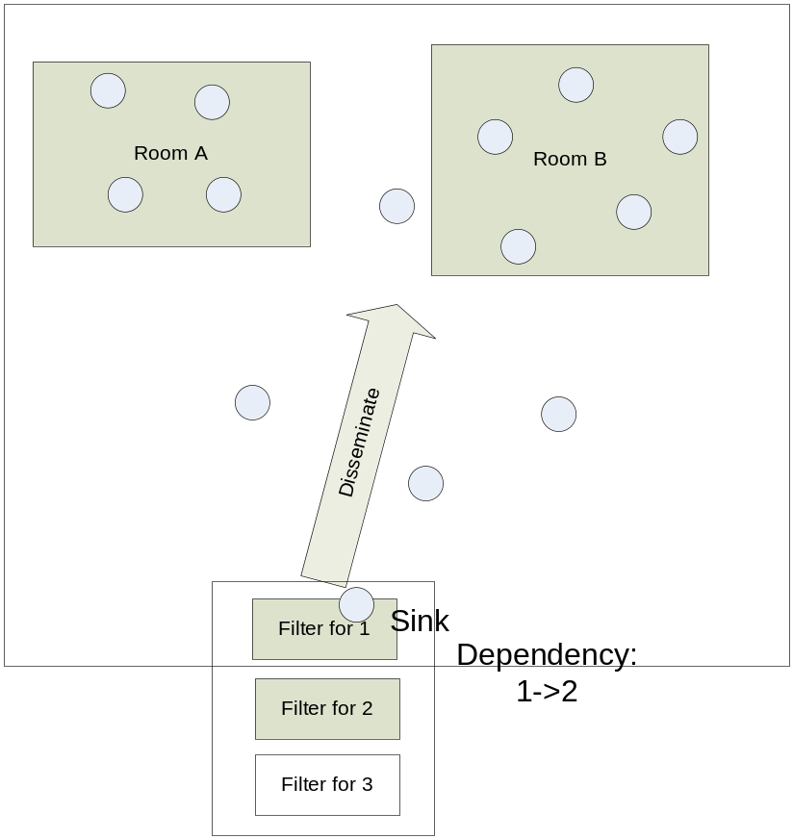
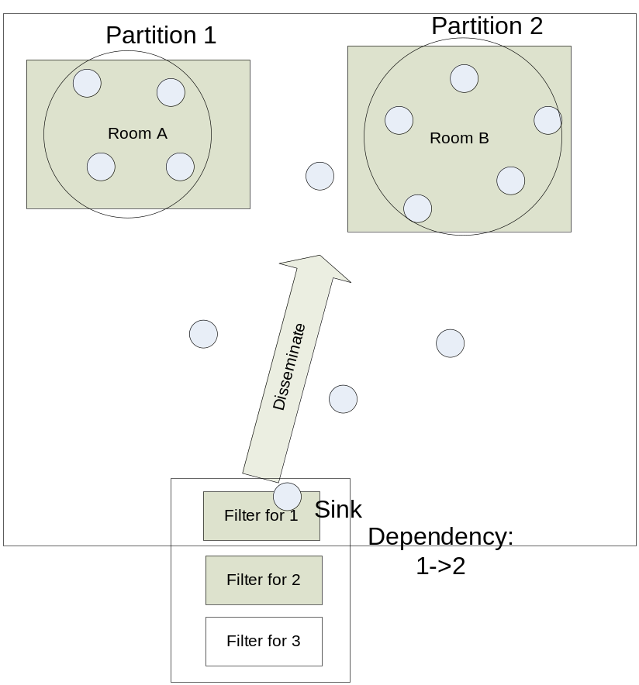

Slide 9
System model
  Sensor nodes distributed in a convex area.
  Given:
    A set of events: {e1, e2, … ei}
    Event relationship list: {d1, d2, … di}
    Static event filters: {f1, f2, … fi}
    A routing protocol (multiple sensor nodes -> sink)
  Algorithms / Protocols:
    Network partition (with leader election)
    Data aggregation

Slide 10
Algorithm Overview
  Event Analysis:
    Event ID
    Event relationship {parent, child, relation}
    Event filters: executable codes on the sensor nodes
  Network Partition
    Partition based on filters
    Leader election within partition
    Set up inter-partition communication link (based on event relationship).
  Data Aggregation
    Intra-partition: based on the routing path within the partition
    Inter-partition: based on the inter-partition communication link

Slide 11
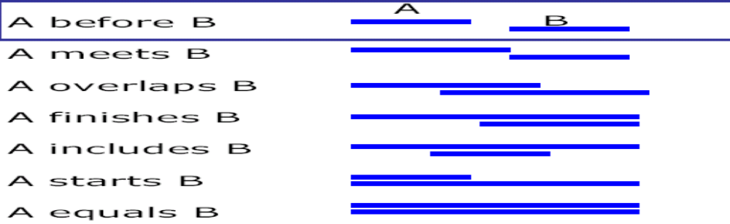
Event Relationship (Temporal)
  Key attributes:
    Start time
    End time
    Detection time
  Relationship should be expressed in terms of the three attributes
    B.startTime-A.startTime=10 && B.endTime-A.endTime=4

Slide 12
Event Relationship
  For a set of nodes responsible for an event:
    When should nodes start to aggregate?
    When should nodes stop to aggregate?
  Solution:
    Nodes should keep track on the temporal constraints.
    Some nodes should be responsible for triggering data aggregation

Slide 13
Event Filters
  Types of Events
    With boundary
    Without boundary
  Filters:
    Static event filters: ID=5
    Memory-free filters:
      LightEvent e = new LightEvent();
      if (e.loc>3) {
      …
      }
    Dynamic event filters: temp>30
    Memory-aware filters:
      LightEvent prev = new LightEvent();
      walkthrough {
      LightEvent e = new LightEvent();
      if (e.light>prev.light) {
      prev=e;
      }
      }

Slide 14
Network Partition
  Sort the events by ‘detection time’.
  Build an aggregation tree for each partition:
    In the reverse order of ‘detection time’
    The partition aggregators is chosen with the fewest number of hops to the next partition
    Within each tree, some normal aggregators will be chosen.
    During the tree construction, the estimated detection duration can be estimated.

Slide 15
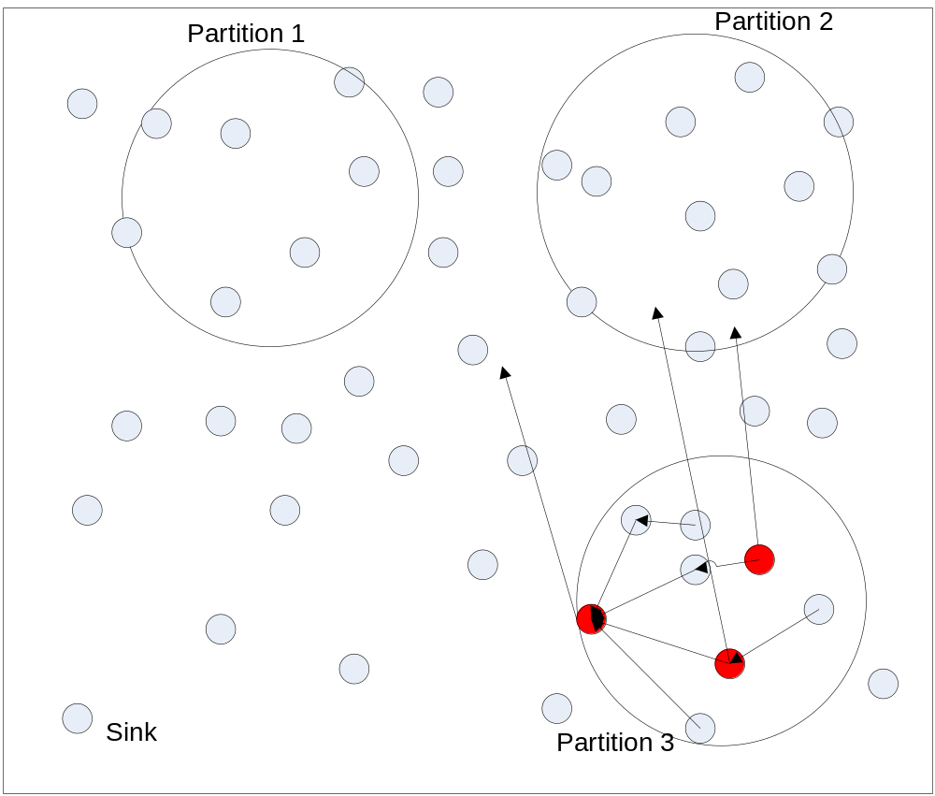
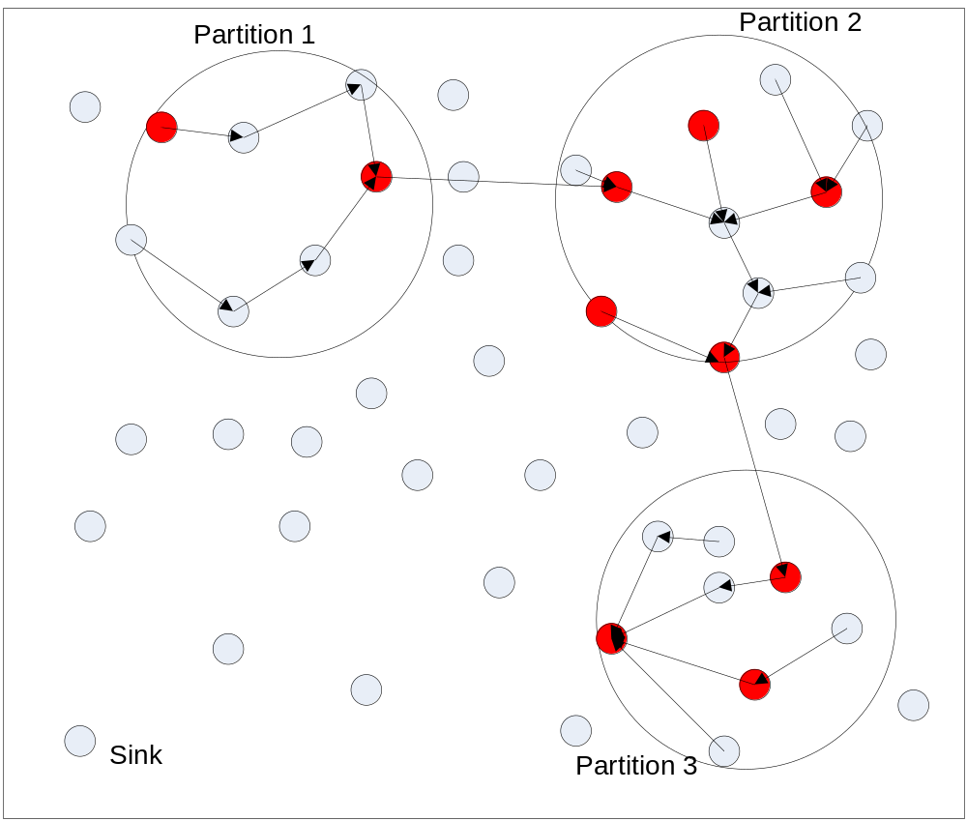
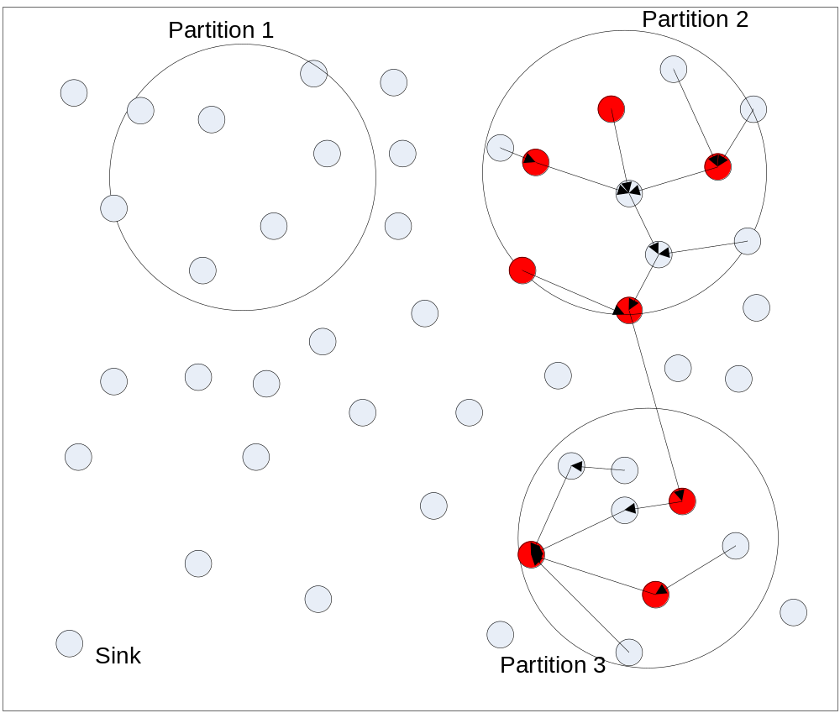

Slide 16
Data Aggregation
  Leaders in the tree:
    Normal leader knows: current.detectionTime, current.endTime?
    Partition Leader knows: current.startTime, current.endTime
  Normal leaders:
    Wait for the child’s aggregation data
    Upon receiving the aggregation data, check the temporal constraints and take actions
  Partition leaders:
    Event detected: forward kick-start message.
    Event undetected: forward cancel message.

Slide 17
Normal Leader’s Algorithm
Temporal constraints:
  Next.startTime-Current.startTime=threshold
  Next.endTime-Current.endTime=threshold
Receive (current.detectionTime):
  localTime-durationDiff-currentEvent.detectionTime==threshold: forward the ‘kick-start’ message to the ‘next’ partition
  Event not detected: forward the ‘cancel’ message

Slide 18

Weekly Reports (10/03/2008)
Implementation
  Compiler
  VM on sensor nodes
  Event notification mechanism (simple version)
  Tested two sample programs

Slide 19
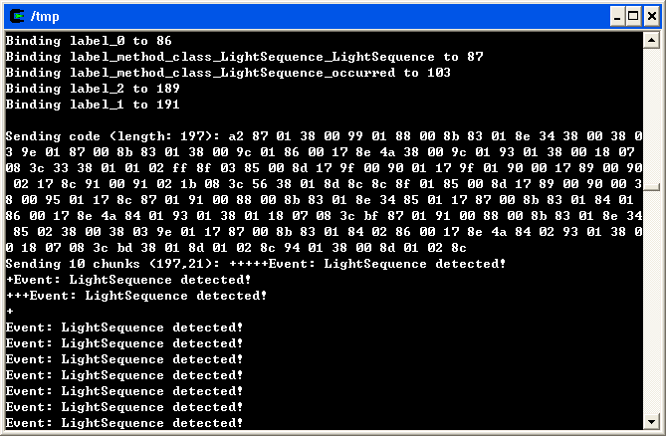
Interface

Slide 20
Next Week’s Plan
Remaining Issues (sorted by priority)
  Memory management
  Implementation of the Aggregation Protocol
  Multiple program submission
  Replace Walkthrough with a private function
  Program optimization (to reduce code image size)

Slide 21
Analysis / Implementation / simulation

Slide 22
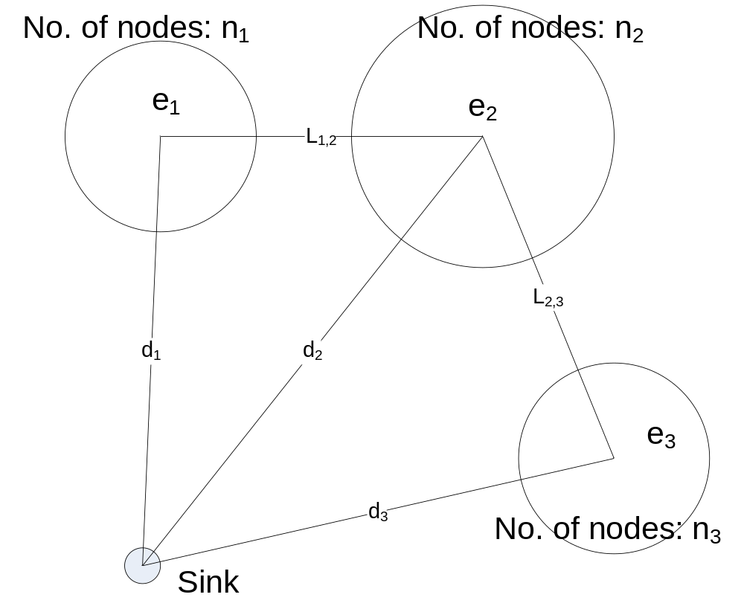
Analysis
  The event generation rate is R.

Slide 23



  Mathematical results:
    Naïve approach:
    Our approach (all sequential):
    Our approach (all parallel):
  Observations:
    Event probability lower -> save more energy with our algorithm.
    l < d -> save more energy with our algorithm
    Poor performance if correlated events are far apart

Slide 24
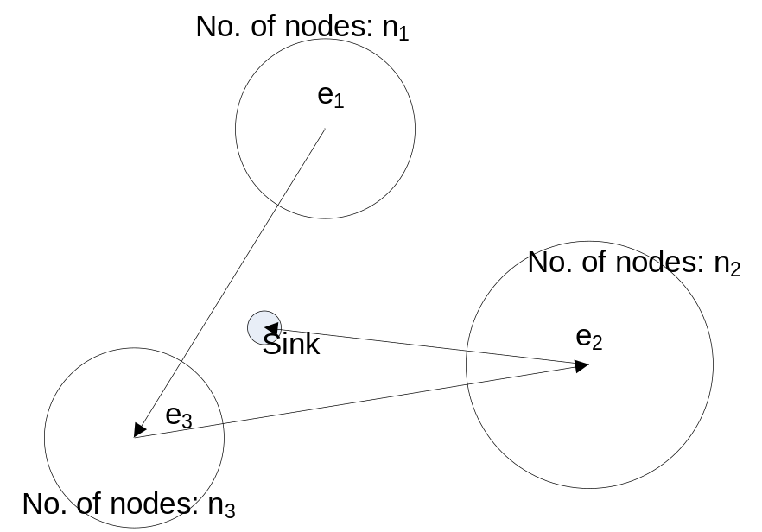
Short term goals:
  Implementation and simulation.
  Extend the work to more complicated scenarios such as dynamic events.

Slide 25
Weekly Reports (17/04/2008)
Paper writing
  Revised introduction & related works
  Written the system design part
Collaboration
  Worked with Liu Yang on the temperature controlling program. Finished interface – now we no longer need to rely on MoteView

Slide 26
Next Week Plan
Resume the implementation
  Solve the memory management issue
Paper
  Discuss and continue to write implementation part

Slide 27
Weekly Reports (24/04/2008)
Implementation
  Finished with the memory management problem
Paper writing
  Read and revised paper again

Slide 28
Next Week Plan
Perform the experiments / simulations
  Solve the memory management issue
Paper
  Write the implementation part

